Slide 1

THOUGHT LEADERSHIP
Enterprise Risk Management “ERM”

Slide 2
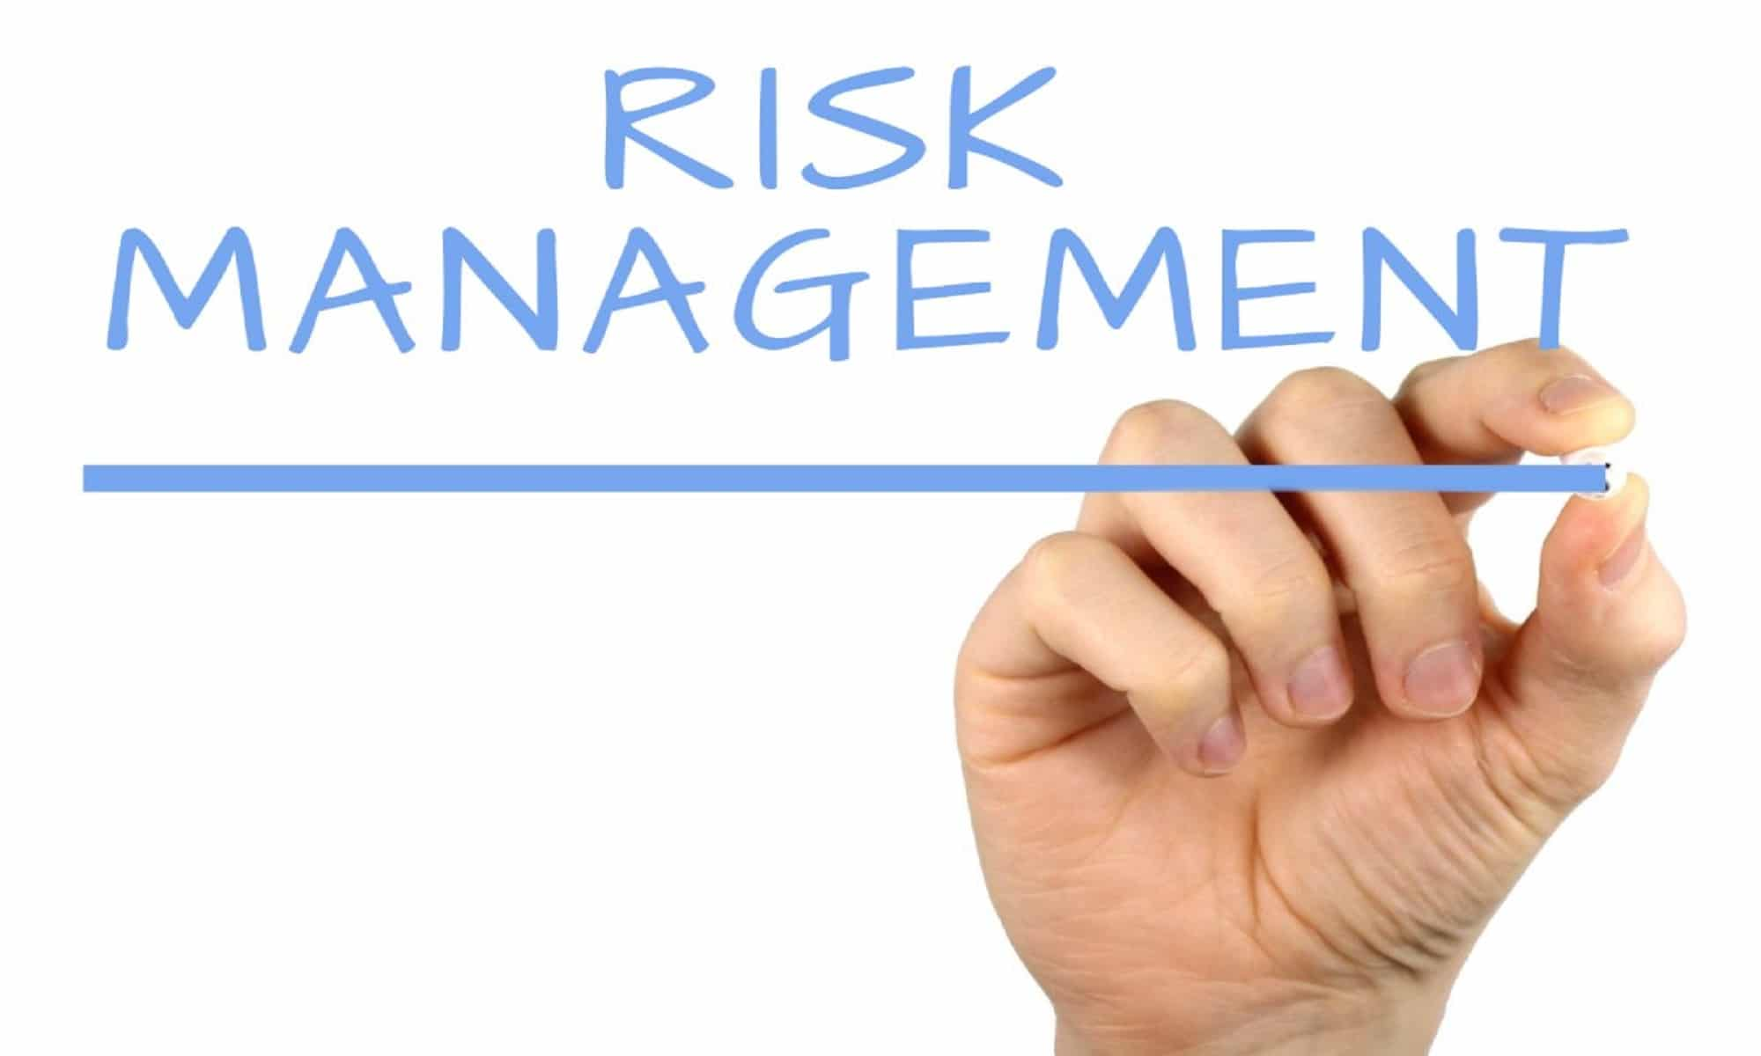
Overview
Enterprise risk management (ERM) is a systematic approach to identifying risks associated with running a business, assessing their likelihood and potential impact, and developing strategies to manage and mitigate them. Most businesses have some kind of risk management program in place.
ERM is a holistic approach, requiring communication and coordination between business units to identify and manage risks across the entire organization.
This Photo by Unknown Author is licensed under CC BY-SA

Slide 3

Enterprise Risk Management process
Processes of Enterprise Risk Management
1. Setting goals
This involves defining the organization’s goals and objectives and aligning them with its tolerance for risk. A business should recognize that long-range strategic plans are fraught with risks that could translate into opportunities–or dangers.
2. Internal workflows
Internal factors that influence the organization’s risk management include its management structure, governance, and company culture. These factors determine the enterprise’s risk appetite and what kinds of risks it needs to manage. While it is senior management (and, in many organizations, the company’s board of directors) that typically identifies what risks require managing, many organizations also engage employee input.
This Photo by Unknown Author is licensed under CC BY-NC

Slide 4

Enterprise Risk Management process
3. Identifying risks
This involves identifying risks, defined as events or situations, that could affect the organization’s ability to achieve its objectives. These impacts can be either beneficial or harmful to the company’s future operations. An ERM program should identify high-risk events that could be particularly damaging.
4. Assessing risk
In this step, an organization determines how likely the risks it has identified risks are likely to occur. It also prioritizes them based on how significant an impact they might have.
5. Responding to risk
The organization then develops and implements strategies for managing the risks it has identified. One strategy is avoidance. An example would be shedding a business line where the potential dangers outweigh any benefits. A second strategy is maintaining that business line while establishing protocols to reduce any potential damage. A third option is acceptance. A company may choose this route if it determines the possibility of a risk event occurring is low and the costs of reducing potential negative impacts are too high.
This Photo by Unknown Author is licensed under CC BY-NC-ND

Slide 5

Enterprise Risk Management process Cont..
6. Controlling activities
Also known as internal controls, these activities involve implementing policies and procedures to mitigate the identified risks and monitoring their effectiveness. Control activities can be classified as preventative (preventing or mitigating a risk event) or detective (recognizing the risk event and responding appropriately).
7. Monitoring risk activity
This involves continuously monitoring the organization’s risk management processes and controls and making adjustments as needed. A company may wish to contract with an external consultant to evaluate its risk management practices. Whether the monitoring is conducted externally or internally, it should determine how well the ERM process is working, and whether the company is leaving itself vulnerable to any risk despite the processes and policies in place.
8. Communicating information
This step ensures that the organization’s risk management processes and results are communicated to stakeholders. Those within the business overseeing its ERM initiative should gather data and design metrics regarding the company’s risks and how they’re being managed. Sharing this information with senior management and affected employees can ensure their involvement in any needed mitigation.

Slide 6
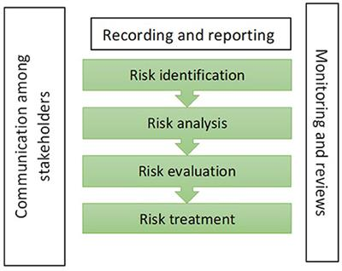
Risk Management Processes Demonstration
This Photo by Unknown Author is licensed under CC BY

Slide 7
What are the benefits of enterprise risk management?
A rigorous, thoughtfully developed enterprise risk management (ERM) program can help avoid financial losses, reputational damage, compliance failures, and legal liability. It also improves business decision-making because it provides more complete information on the risks a company faces. As a result, an ERM program can strengthen corporate governance and oversight and reduce instances of fraud.
Enterprise risk management (ERM) also boosts internal communication and interdepartmental cooperation. The regular risk reports that a firm’s ERM team delivers to upper management include a list or “matrix” of the risks, how these risks are being prepared for or mitigated, and how the risks are being prioritized. This information is crucial for management decision-making and guidance regarding risk response and preparation

Slide 8
Conclusion
In an unpredictable, fast-changing business environment, an enterprise risk management (ERM) initiative is essential. An ERM program includes assessment, prioritizing, and mitigation of any potential risk to a company’s future health and success. And wherever necessary, it solicits the participation and input of all stakeholders—senior management, board of directors, employees, and customers.
The benefits of a well-crafted risk management strategy include thorough regulatory compliance, a clearer sense of how strategic risks can help or hurt a business, and improved decision-making about operations, opportunities, and future planning. It’s not stated too strongly to say that an enterprise risk management program could mean the difference between maintaining a successful business—or going out of business entirely.

